Slide 1

Offuture Data
What is the big picture?

Slide 2
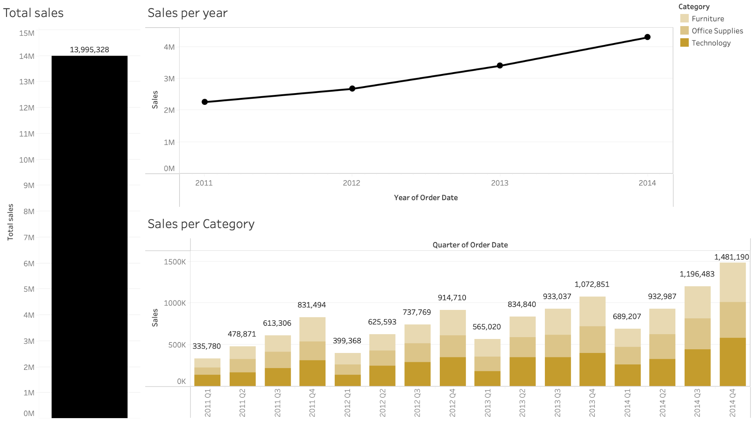
Sales overview
Notes:
Starting with a general overview of the sales data.
We initially calculated the total sales including shipping cost, which was just under 14 million.
Exploring annual sales we can see that sales have been increasing each year - showing consistent growth from 2011 through to 2014 (as a quick aside that we chose not include 2015 in the line graph since the data is incomplete).
If we look further at the individual quarters - we can see that sales were relatively modest in the earlier years, but picked up significantly later on.
In fact, we also noticed that Q4 consistently generated the highest sales each year with 2014 Q4 reaching the peak at around 1.48 million.
Breaking it down further by category, we are able to identify that office supplies stayed relatively stable, while technology and furniture show strong gains in the latter quarters.
Overall the data highlights a clear upward trend and strong momentum particularly in 2014.

Slide 3
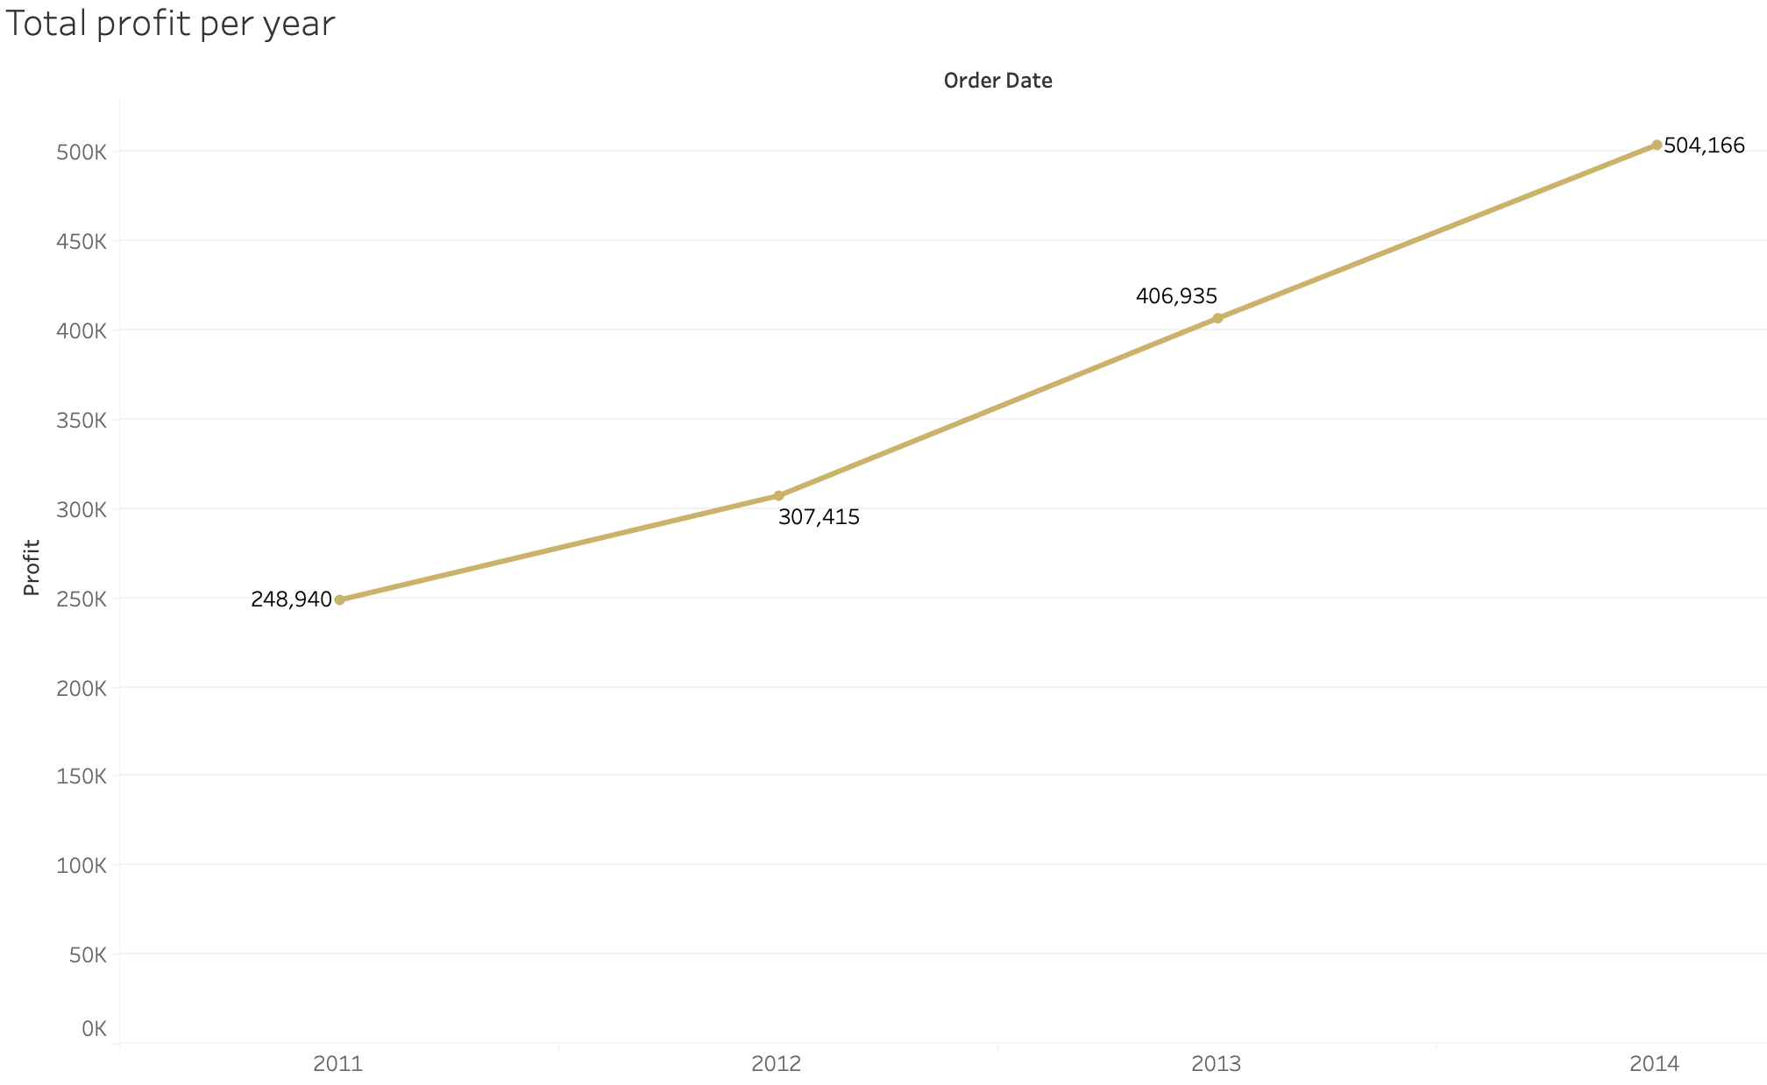
Profit overview

Slide 4
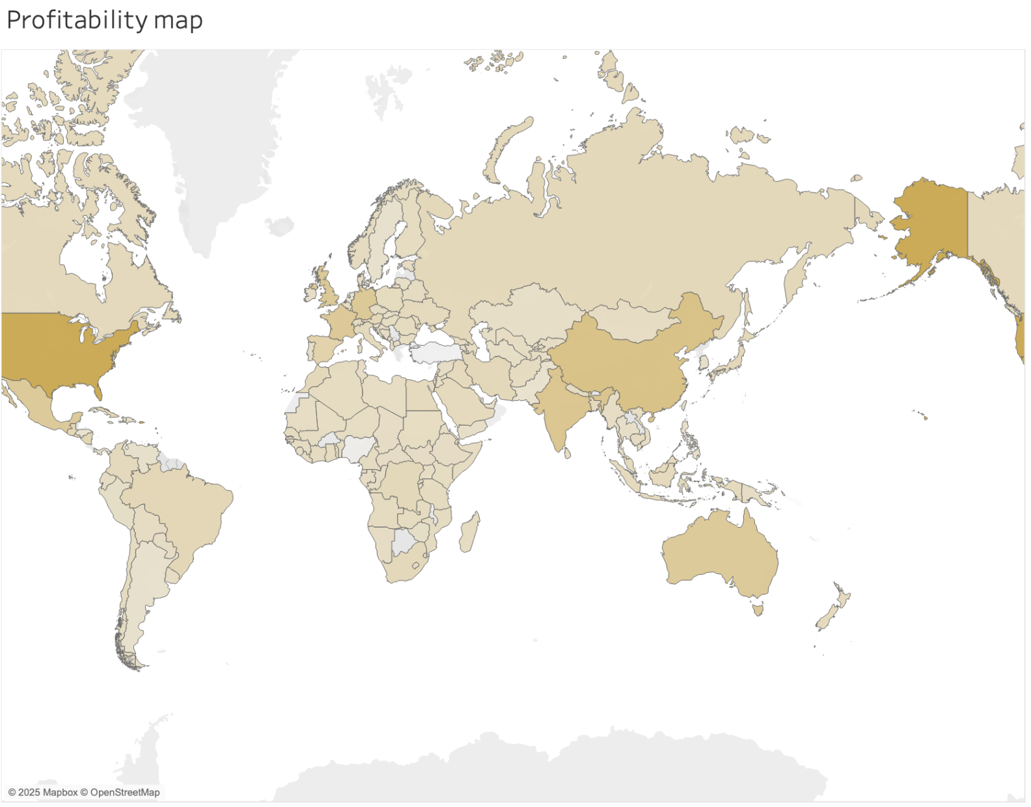
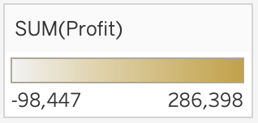
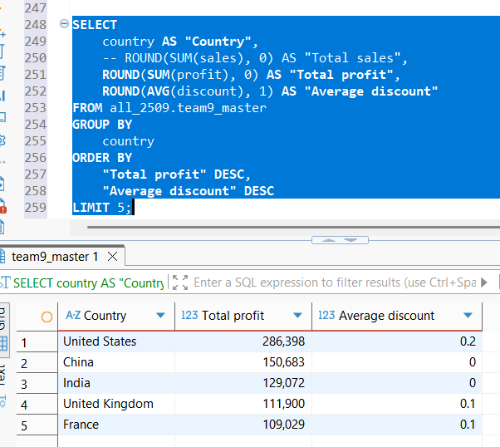
Profit overview
Top five most profitable countries:

Slide 5
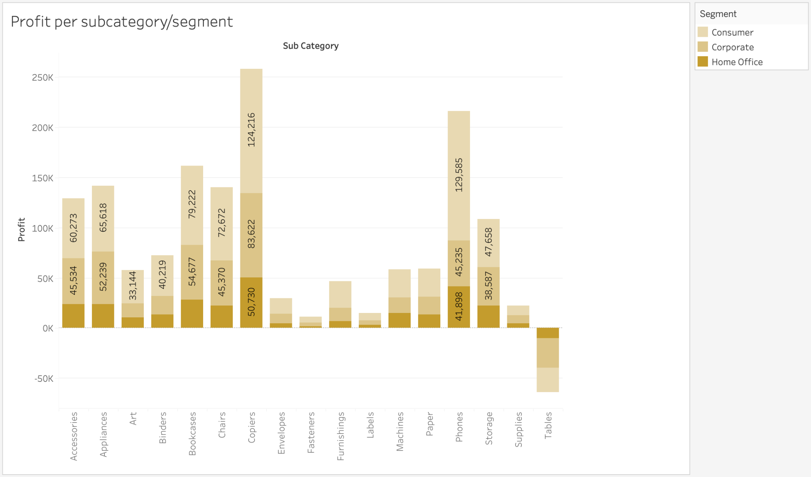
Profit overview

Slide 6
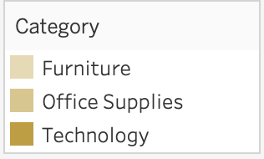
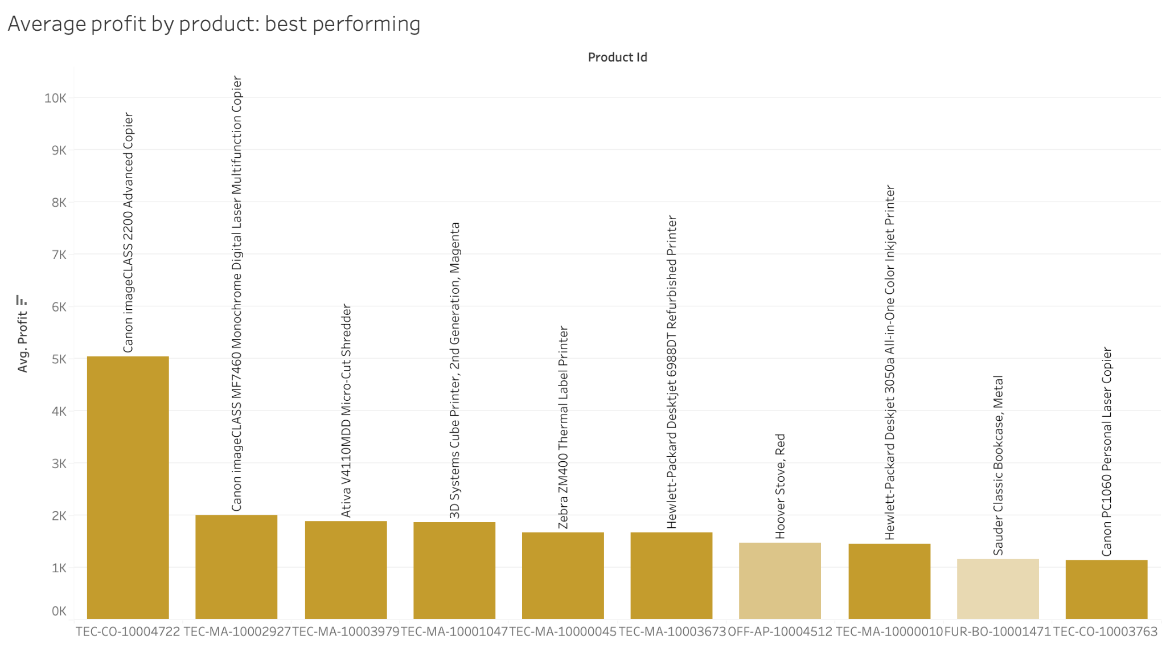
Average profit by product: best performing
The most profitable items tend to be the copiers and printers.

Slide 7
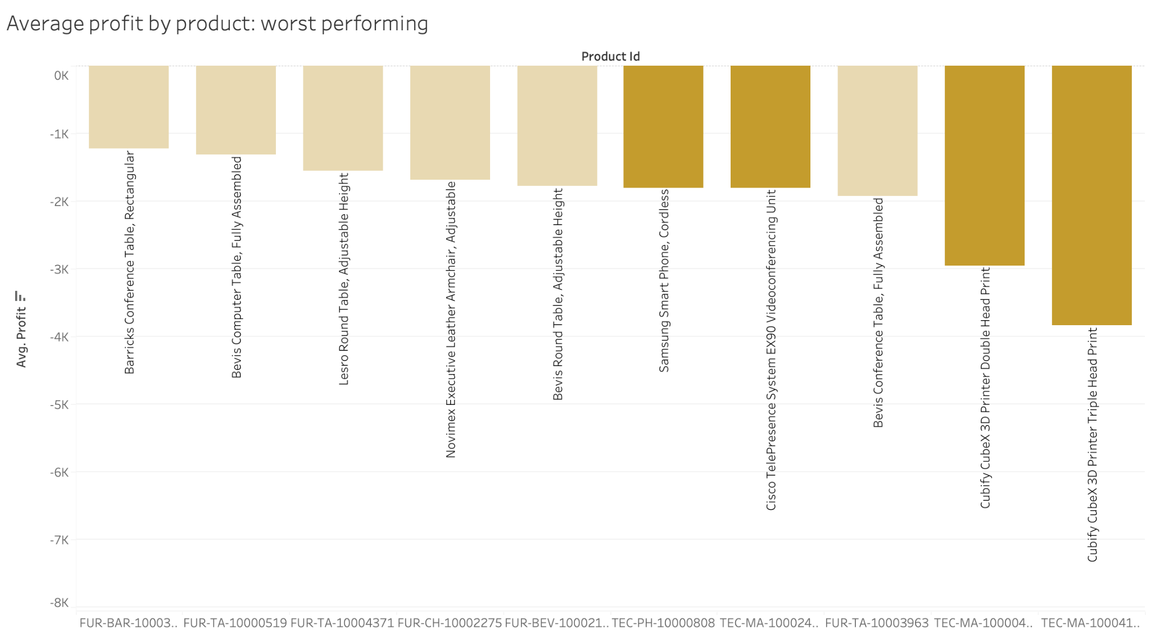
Average profit by product: worst performing
The least profitable items tend to be the tables.

Slide 8
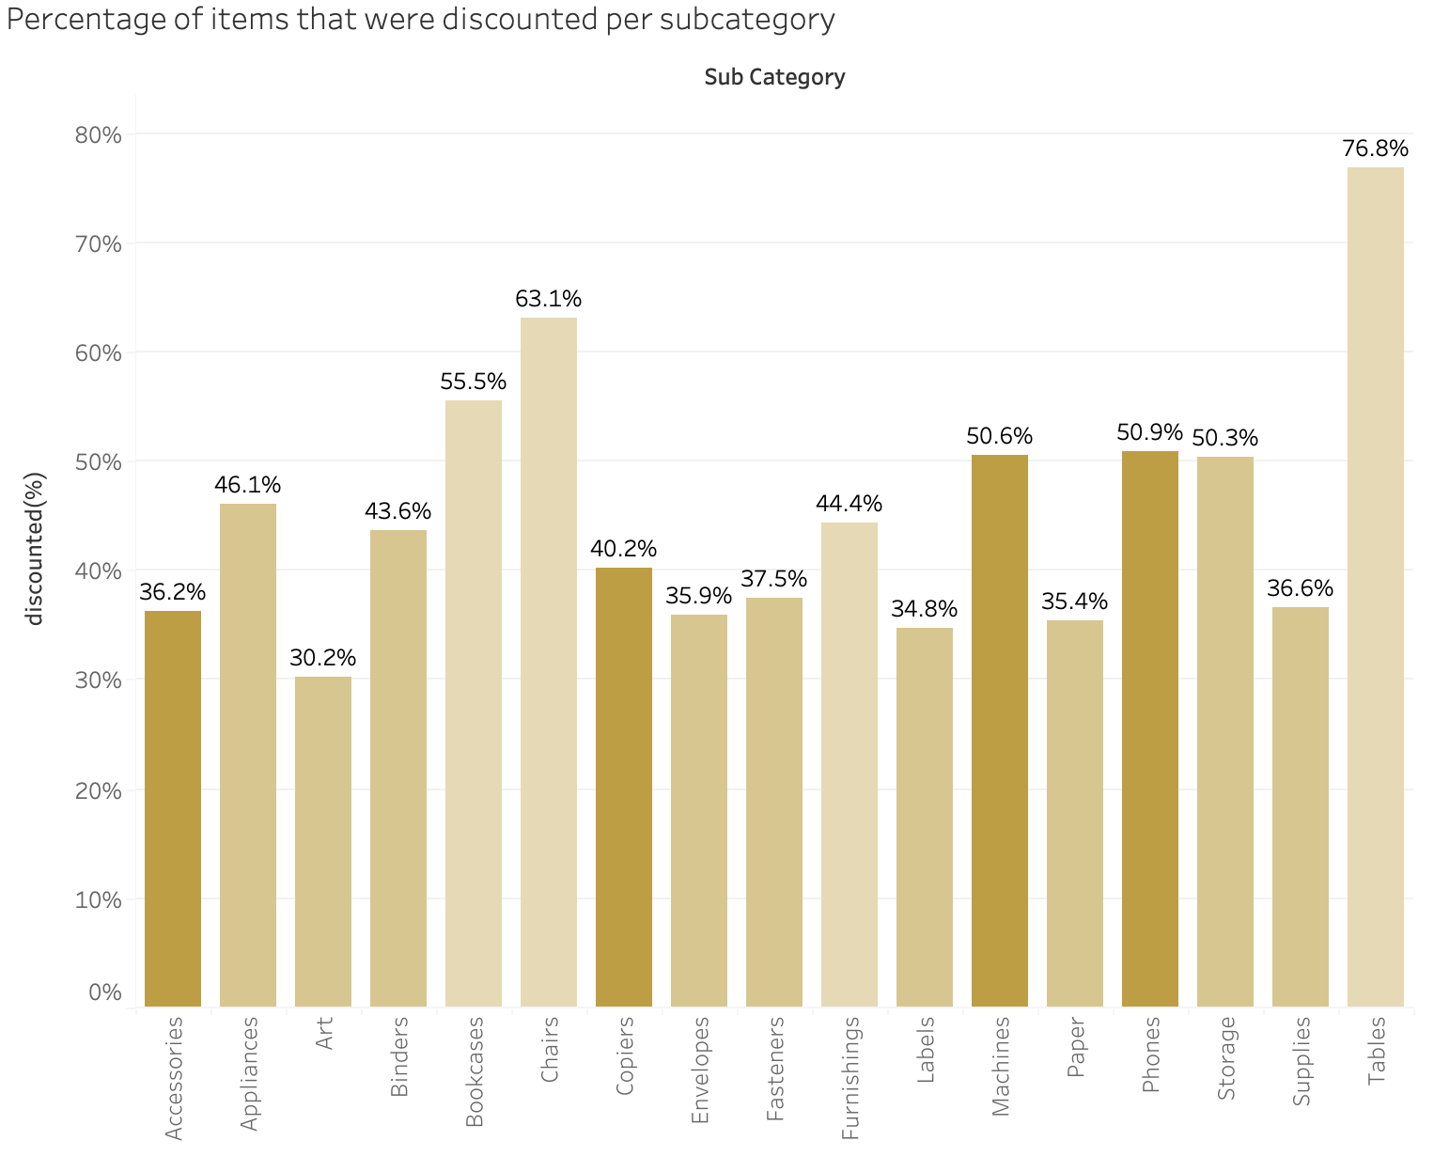
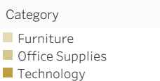

Discounts and sub-categories
Tables were the most often discounted subcategory.
Art was the least often discounted subcategory.

Slide 9
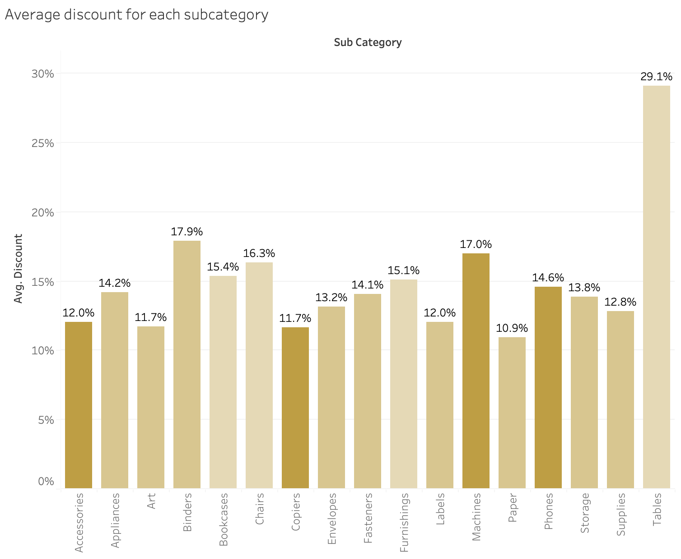
Discounts and sub-categories
Tables showed to have the highest discount on average.
Paper showed to have the lowest discount on average.

Slide 10
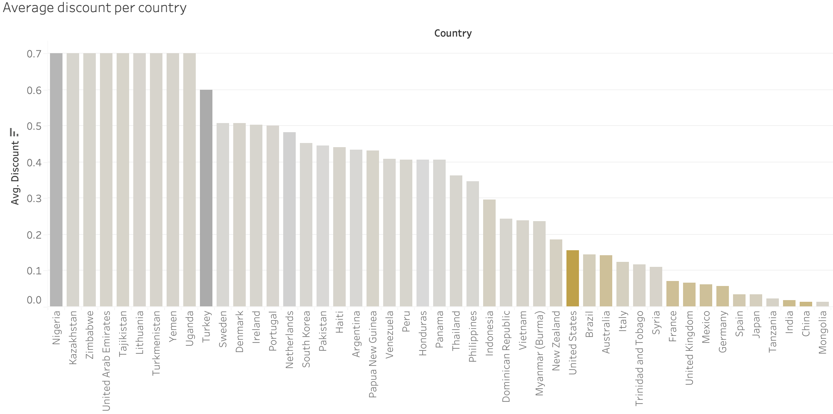
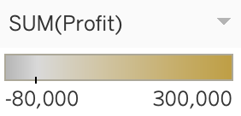
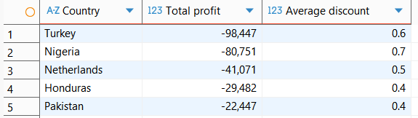
Discounts and regions
The 5 most profitable countries
The 5 least profitable countries

Slide 11
Conclusion and key findings:
Total sales and profits increased year by year, and sales were particularly high in Q4 each year.
Subcategories varied in profitability, with the most profitable segment being in Consumer goods. Copiers and Phones were very profitable, whereas Tables made a loss.
Tables were both the most often discounted good, and had the largest discount percentages on average.
Countries with positive profits tended to have far lower discounts then those with negative profits.

